Slide 1
Functions

Slide 2
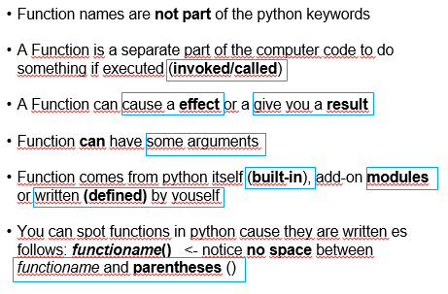
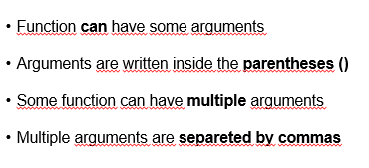
Function definition (or signature)
Function body
Function call
Function effects
Functions return values
Function arguments

Slide 3
Functions

Slide 4

What happens if a function is invoked?
Python checks if the function name specified is legal
Python checks the requirements for the number of arguments
Python leaves your code for a moment and jumps into the function you want to invoke
function_name()
The code inside the function will be executed
Python returns to your code and resumes ist execution
functions

Slide 5
def calculate_premium_with_costs(insured_sum, costs):
return insured_sum + (insured_sum * costs / 100)
print(calculate_premium_with_costs(1500, 5))
print(calculate_premium_with_costs(200, 15))
Functions with arguments

Slide 6
def calculate_premium(insured_sum):
lower_costs = 5 # 5% of the insured sum
higher_costs = 15 # 15% of the insured sum
fix_costs = 200 # fixed, 200e
if insured_sum > 1000:
payment = insured_sum + (insured_sum * higher_costs / 100) + fix_costs
else:
payment = insured_sum + (insured_sum * lower_costs / 100)
return payment
Functions can call other functions
Functions with arguments

Slide 7
def calculate_premium(insured_sum):
lower_costs = 5 # 5% of the insured sum
higher_costs = 15 # 15% of the insured sum
fix_costs = 200 # fixed, 200e
if insured_sum > 1000:
payment = calculate_premium_with_costs(insured_sum, higher_costs) + fix_costs
else:
payment = calculate_premium_with_costs(insured_sum, lower_costs)
return payment
Functions can call other functions

Slide 8
def first_function(name = “Milica”, greeting = “good evening”):
print("Hello, {name}! I wish you {greeting}")
first_function("Maria", "a good day!")
first_function()
first_function(name = “Paul")
If a default value is defined, it will be used if a function is used without arguments or with an insufficient number of arguments
Functions with default parameters values

Slide 9
def first_function(list_of_students):
for student in list_of_students
print(f"Hello, {name}!")
students = ["Marwa“, “Beny“, “Ksenia"]
first_function(students)
List as an input parameter!
Functions with list parameters

Slide 10
def list_with_numbers(start, end):
list_with_numbers = []
for number in range(start,end)
list_with_numbers.append(number)
return list_with_numbers
print(list_with_numbers(4,8))
List as return value!
Functions with list return value

